Slide 1
Depth-First Search

Slide 2
Agenda
Introduction
Real life example
Algorithm
Working
Complexity
Applications

Slide 3
Depth-First Search (DFS)
DFS is another popular graph search strategy
  Finds a path between two vertices by exploring each possible path as far as possible before backtracking.
DFS will continue to visit neighbors in a recursive pattern
  Whenever we visit v from u, we recursively visit all unvisited neighbors of v. Then we backtrack (return) to u.

Slide 4
DFS Algorithm Idea
Similar to BFS algorithm, except that we use a stack instead of a queue for backtracking.
  Idea is similar to pre-order traversal (visit node, then visit children recursively)
In practice, we use recursion instead of an explicit stack.

Slide 5
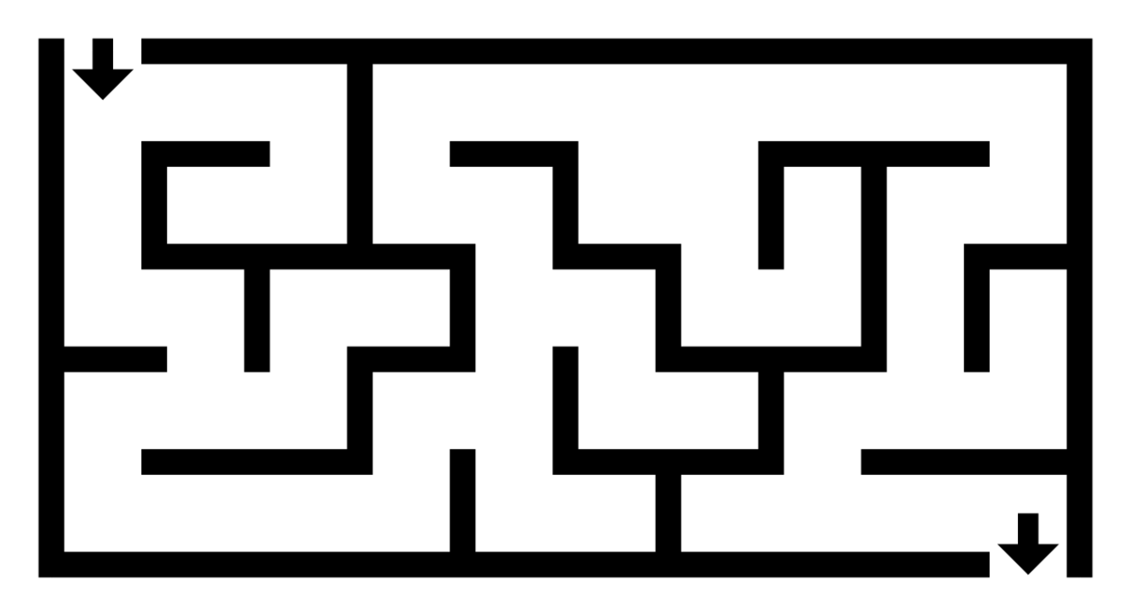
Real Life Example
For solving puzzles with a single solution

Slide 6
DFS Algorithm
DFS will continue to visit neighbors in a recursive pattern
  Whenever we visit v from u, we recursively visit all unvisited neighbors of v. Then we backtrack (return) to u.
  Note: it is possible that w2 was unvisited when we recursively visit w1, but became visited by the time we return from the recursive call.
u
v
w3
w1
w2

Slide 7
DFS Algorithm
RDFS(v)
v is visited
W = {unvisited neighbors of v}
for each w in W
RDFS(w)

Slide 8
observe the similarity with the pre-ordering traversal of trees …

Slide 9
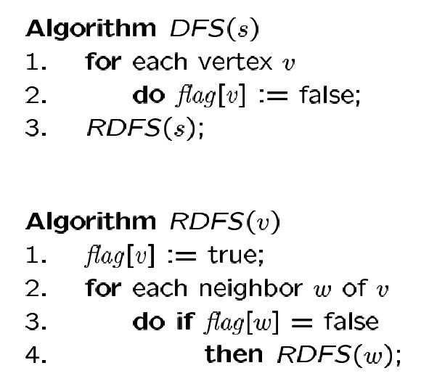
DFS Algorithm
Flag all vertices as not
visited
Flag yourself as visited
For unvisited neighbors,
call RDFS(w) recursively
We can also record the paths using pred[ ].

Slide 10
Use a stack S for DFS instead of a queue Q for BFS
DFS (s)
Initialization:
s is visited
S is empty
push(S,s)
while not-empty(S)
v <- pop(S)
W = {unvisited neighbors of v}
for each w in W
w is visited
push(S,w)

Slide 11
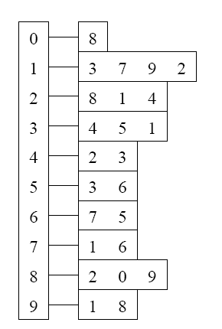
Example
Adjacency List
Visited Table (T/F)
0
0
1
2
3
4
5
6
7
8
9
F
F
F
F
F
F
F
F
F
F
-
-
-
-
-
-
-
-
-
-
8
source
2
9
1
3
7
6
4
5
Pred
Initialize visited
table (all False)
Initialize Pred to -1

Slide 12
Adjacency List
Visited Table (T/F)
0
0
1
2
3
4
5
6
7
8
9
F
F
T
F
F
F
F
F
F
F
-
-
-
-
-
-
-
-
-
-
8
source
2
9
1
3
7
6
4
5
Pred
Mark 2 as visited
RDFS( 2 )
Now visit RDFS(8)

Slide 13
Adjacency List
Visited Table (T/F)
0
8
0
1
2
3
4
5
6
7
8
9
F
F
T
F
F
F
F
F
T
F
-
-
-
-
-
-
-
-
2
-
source
2
9
1
3
7
6
4
5
Pred
Mark 8 as visited
mark Pred[8]
Recursive
calls
RDFS( 2 )
RDFS(8)
2 is already visited, so visit RDFS(0)

Slide 14
Adjacency List
Visited Table (T/F)
0
8
0
1
2
3
4
5
6
7
8
9
T
F
T
F
F
F
F
F
T
F
8
-
-
-
-
-
-
-
2
-
source
2
9
1
3
7
6
4
5
Pred
Mark 0 as visited
Mark Pred[0]
Recursive
calls
RDFS( 2 )
RDFS(8)
RDFS(0) -> no unvisited neighbors, return
to call RDFS(8)

Slide 15
Back to 8
Adjacency List
Visited Table (T/F)
0
8
0
1
2
3
4
5
6
7
8
9
T
F
T
F
F
F
F
F
T
F
8
-
-
-
-
-
-
-
2
-
source
2
9
1
3
7
6
4
5
Pred
Recursive
calls
RDFS( 2 )
RDFS(8)
Now visit 9 -> RDFS(9)

Slide 16
Adjacency List
Visited Table (T/F)
0
8
0
1
2
3
4
5
6
7
8
9
T
F
T
F
F
F
F
F
T
T
8
-
-
-
-
-
-
-
2
8
source
2
9
1
3
7
6
4
5
Pred
Mark 9 as visited
Mark Pred[9]
Recursive
calls
RDFS( 2 )
RDFS(8)
RDFS(9)
-> visit 1, RDFS(1)

Slide 17
Adjacency List
Visited Table (T/F)
0
8
0
1
2
3
4
5
6
7
8
9
T
T
T
F
F
F
F
F
T
T
8
9
-
-
-
-
-
-
2
8
source
2
9
1
3
7
6
4
5
Pred
Mark 1 as visited
Mark Pred[1]
Recursive
calls
RDFS( 2 )
RDFS(8)
RDFS(9)
RDFS(1)
visit RDFS(3)

Slide 18
Adjacency List
Visited Table (T/F)
0
8
0
1
2
3
4
5
6
7
8
9
T
T
T
T
F
F
F
F
T
T
8
9
-
1
-
-
-
-
2
8
source
2
9
1
3
7
6
4
5
Pred
Mark 3 as visited
Mark Pred[3]
Recursive
calls
RDFS( 2 )
RDFS(8)
RDFS(9)
RDFS(1)
RDFS(3)
visit RDFS(4)

Slide 19
Adjacency List
Visited Table (T/F)
0
8
0
1
2
3
4
5
6
7
8
9
T
T
T
T
T
F
F
F
T
T
8
9
-
1
3
-
-
-
2
8
source
2
9
1
3
7
6
4
5
Pred
RDFS( 2 )
RDFS(8)
RDFS(9)
RDFS(1)
RDFS(3)
RDFS(4) → STOP all of 4’s neighbors have been visited
return back to call RDFS(3)
Mark 4 as visited
Mark Pred[4]
Recursive
calls

Slide 20
Adjacency List
Visited Table (T/F)
0
8
0
1
2
3
4
5
6
7
8
9
T
T
T
T
T
F
F
F
T
T
8
9
-
1
3
-
-
-
2
8
source
2
9
1
3
7
6
4
5
Back to 3
Pred
RDFS( 2 )
RDFS(8)
RDFS(9)
RDFS(1)
RDFS(3)
visit 5 -> RDFS(5)
Recursive
calls

Slide 21
Adjacency List
Visited Table (T/F)
0
8
0
1
2
3
4
5
6
7
8
9
T
T
T
T
T
T
F
F
T
T
8
9
-
1
3
3
-
-
2
8
source
2
9
1
3
7
6
4
5
Pred
RDFS( 2 )
RDFS(8)
RDFS(9)
RDFS(1)
RDFS(3)
RDFS(5)
3 is already visited, so visit 6 -> RDFS(6)
Recursive
calls
Mark 5 as visited
Mark Pred[5]

Slide 22
Adjacency List
Visited Table (T/F)
0
8
0
1
2
3
4
5
6
7
8
9
T
T
T
T
T
T
T
F
T
T
8
9
-
1
3
3
5
-
2
8
source
2
9
1
3
7
6
4
5
RDFS( 2 )
RDFS(8)
RDFS(9)
RDFS(1)
RDFS(3)
RDFS(5)
RDFS(6)
visit 7 -> RDFS(7)
Pred
Recursive
calls
Mark 6 as visited
Mark Pred[6]

Slide 23
Adjacency List
Visited Table (T/F)
0
8
0
1
2
3
4
5
6
7
8
9
T
T
T
T
T
T
T
T
T
T
8
9
-
1
3
3
5
6
2
8
source
2
9
1
3
7
6
4
5
Pred
RDFS( 2 )
RDFS(8)
RDFS(9)
RDFS(1)
RDFS(3)
RDFS(5)
RDFS(6)
RDFS(7) -> Stop no more unvisited neighbors
Recursive
calls
Mark 7 as visited
Mark Pred[7]

Slide 24
Adjacency List
Visited Table (T/F)
0
0
1
2
3
4
5
6
7
8
9
T
T
T
T
T
T
T
T
T
T
8
9
-
1
3
3
5
6
2
8
8
source
2
9
1
3
7
6
4
5
RDFS( 2 )
RDFS(8)
RDFS(9)
RDFS(1)
RDFS(3)
RDFS(5)
RDFS(6) -> Stop
Pred
Recursive
calls

Slide 25
Adjacency List
Visited Table (T/F)
0
0
1
2
3
4
5
6
7
8
9
T
T
T
T
T
T
T
T
T
T
8
9
-
1
3
3
5
6
2
8
8
source
2
9
1
3
7
6
4
5
RDFS( 2 )
RDFS(8)
RDFS(9)
RDFS(1)
RDFS(3)
RDFS(5) -> Stop
Pred
Recursive
calls

Slide 26
Adjacency List
Visited Table (T/F)
0
0
1
2
3
4
5
6
7
8
9
T
T
T
T
T
T
T
T
T
T
8
9
-
1
3
3
5
6
2
8
8
source
2
9
1
3
7
6
4
5
RDFS( 2 )
RDFS(8)
RDFS(9)
RDFS(1)
RDFS(3) -> Stop
Pred
Recursive
calls

Slide 27
Adjacency List
Visited Table (T/F)
0
0
1
2
3
4
5
6
7
8
9
T
T
T
T
T
T
T
T
T
T
8
9
-
1
3
3
5
6
2
8
8
source
2
9
1
3
7
6
4
5
RDFS( 2 )
RDFS(8)
RDFS(9)
RDFS(1) -> Stop
Pred
Recursive
calls

Slide 28
Adjacency List
Visited Table (T/F)
0
0
1
2
3
4
5
6
7
8
9
T
T
T
T
T
T
T
T
T
T
8
9
-
1
3
3
5
6
2
8
8
source
2
9
1
3
7
6
4
5
RDFS( 2 )
RDFS(8)
RDFS(9) -> Stop
Pred
Recursive
calls

Slide 29
Adjacency List
Visited Table (T/F)
0
0
1
2
3
4
5
6
7
8
9
T
T
T
T
T
T
T
T
T
T
8
9
-
1
3
3
5
6
2
8
8
source
2
9
1
3
7
6
4
5
RDFS( 2 )
RDFS(8) -> Stop
Pred
Recursive
calls

Slide 30
Example Finished
Adjacency List
Visited Table (T/F)
0
0
1
2
3
4
5
6
7
8
9
T
T
T
T
T
T
T
T
T
T
8
9
-
1
3
3
5
6
2
8
8
source
2
9
1
3
7
6
4
5
RDFS( 2 ) -> Stop
Pred
Recursive calls finished

Slide 31

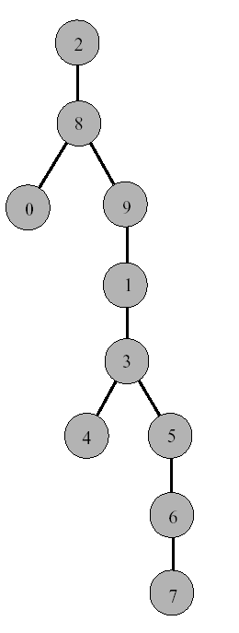
DFS Tree
Resulting DFS-tree.
Notice it is much “deeper”
than the BFS tree.
Captures the structure of the recursive calls
when we visit a neighbor w of v, we add w as child of v
whenever DFS returns from a vertex v, we climb up in the tree from v to its parent

Slide 32
Time Complexity of DFS
(Using adjacency list)
We never visited a vertex more than once
We had to examine all edges of the vertices
  We know Σ_{vertex v} degree(v) = 2m where m is the number of edges
So, the running time of DFS is proportional to the number of edges and number of vertices (same as BFS)
  O(n + m)
You will also see this written as:
  O(|v|+|e|) |v| = number of vertices (n) |e| = number of edges (m)

Slide 33
Applications
Solving mazes and other puzzles with only one solution by only including nodes the current path in the visited set, DFS is used to locate all keys to a maze.
Detecting a graph's cycle: A graph has a cycle if and only if a back edge is visible during DFS. As a result, you may run DFS on the graph to look for rear edges.

